Slide 1
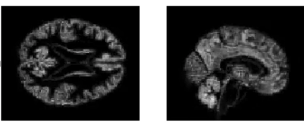
MRI-Learn: A Comprehensive Study of Alzheimer’s Disease Using Machine Learning
Term Project for CS289A, UC Berkeley
Nicolas Andrade
Sean Hooten
Notes:
Hello, my name is Nicolas Andrade…

Slide 2


Typical Brain Scan and ROI Atlas
~290k non-zero voxels
45 Regions of Interest (ROI)
Notes:
According to the CDC, AD is 5th leading cause of death for Americans 65yrs and older and projected to affect over 14million Americans in 2060
On the left we have a typical MRI scan from our dataset, it is preprocessed and has over 290 thousand non-zero voxels
On the right we have the Harvard-Oxford ATLAS depicting 45 regions of interest
------
Discuss motivation:
https://www.cdc.gov/aging/aginginfo/alzheimers.htm
According to the CDC, AD is 5th leading cause of death for Americans 65yrs and older and projected to affect over 14million Americans in 2060
DATA:
On the left we have a typical MRI scan from our dataset, it is preprocessed and has over 290 thousand non-zero voxels
Harvard-Oxford ATLAS for ROI studies:
On the right we have the Harvard-Oxford ATLAS depicting 45 regions of interest

Slide 3
OASIS Dataset
Labels
Alzheimer's Disease (AD): 96 Patients
Cognitively Normal (CN): 97 Patients (>Age 59)
Background Data
Age
Gender
Estimated intercranial volume (eTIV)
Normalized Whole-Brain Volume (nWBV)
ATLAS scaling factor (ASF)
OASIS: Cross-Sectional: https://doi.org/10.1162/jocn.2007.19.9.1498
Notes:
We excluded over 200 healthy patients based on their age since it would give an unbalanced and overoptimistic prediction accuracy
In addition to MRI data we have Background data -- age, gender, and information from preprocessing
We reserved 20% of the balanced data for a test set to prevent data leakage
---
SETS: 20% reserved for test set, 4 fold kcross validation (i.e. at a time 60% training, 20%) 20%=~39

Slide 4
SVM
~290k Voxels
Test Accuracy = 76.9%
~1200 Voxels
Test Accuracy = 69.2%
Notes:
We performed 4 fold kcross validation on the voxels and background data to select the best model – we found that SVM with linear kernel worked best
Our most predictive region of interest, the anterior hippocampus, performed similar to the whole brain training with significantly less voxels. However, in both models we encountered significant overfitting.

Slide 5

SVM Brain Weights
Notes:
Here we visualize the whole brain weights, unsurprisingly we found that the hippocampus, the dark blue cluster, was a predictive feature.
--
since it is grayscale image we can interpret the sign of the weights, positive weights push decision towards AD label, while blue points towards CN. Unsurp

Slide 6
Eigen-Brains (PCA)
Eigen-Brain 0
Eigen-Brain 1
Eigen-Brain 2
Eigen-Brain 3
Notes:
In an attempt to combat overfitting we pursued principle component analysis, here we show a visualization of the first four eigenbrains
–-
note here we cannot interpret the sign of the components, just the grouping

Slide 8
PCA with forward step selection
Notes:
We performed forward step selection on principal components + background data using a linear SVM,
we achieved nearly a 10% increase in validation accuracy compared to voxel based training
Brain 5, 13, 47, 31

Slide 9
Best Eigen-Brains
Eigen-Brain 3
Eigen-Brain 9
Eigen-Brain 5
Eigen-Brain 49
Notes:
These are the first four principal components selected, all eigenbrains, they all emphasize the cerebellum, anterior hippocampus, temporal lobe, or brain stem all thought to be affected by AD.
--
Brain 3 – Cerebellum, anterior hippocampus, temporal lobe
Brain 9 – Occipital pole blue, temporal lobe
Brain 5 – Medula oblongata (brain stem) blue (controls heart + lung function), hippocampus, cerebellum
Brain 49 -
Parietal blue

Slide 11
ROI Deep Neural Network
Notes:
The first neural network architecture used to classify the data was a standard fully-connected deep neural network.
Input data → variable number of ROIs that were flattened into a design matrix and propagated through 3 hidden layers and softmax output.
The input ROIs were selected based on SVM results which suggested the ROIs that were most predictive.
Classified test set as a function of the number of input 3D ROIs
Hidden units, activations, and optimization hyperparameters were selected by validation
Adam optimizer was used.

Slide 12
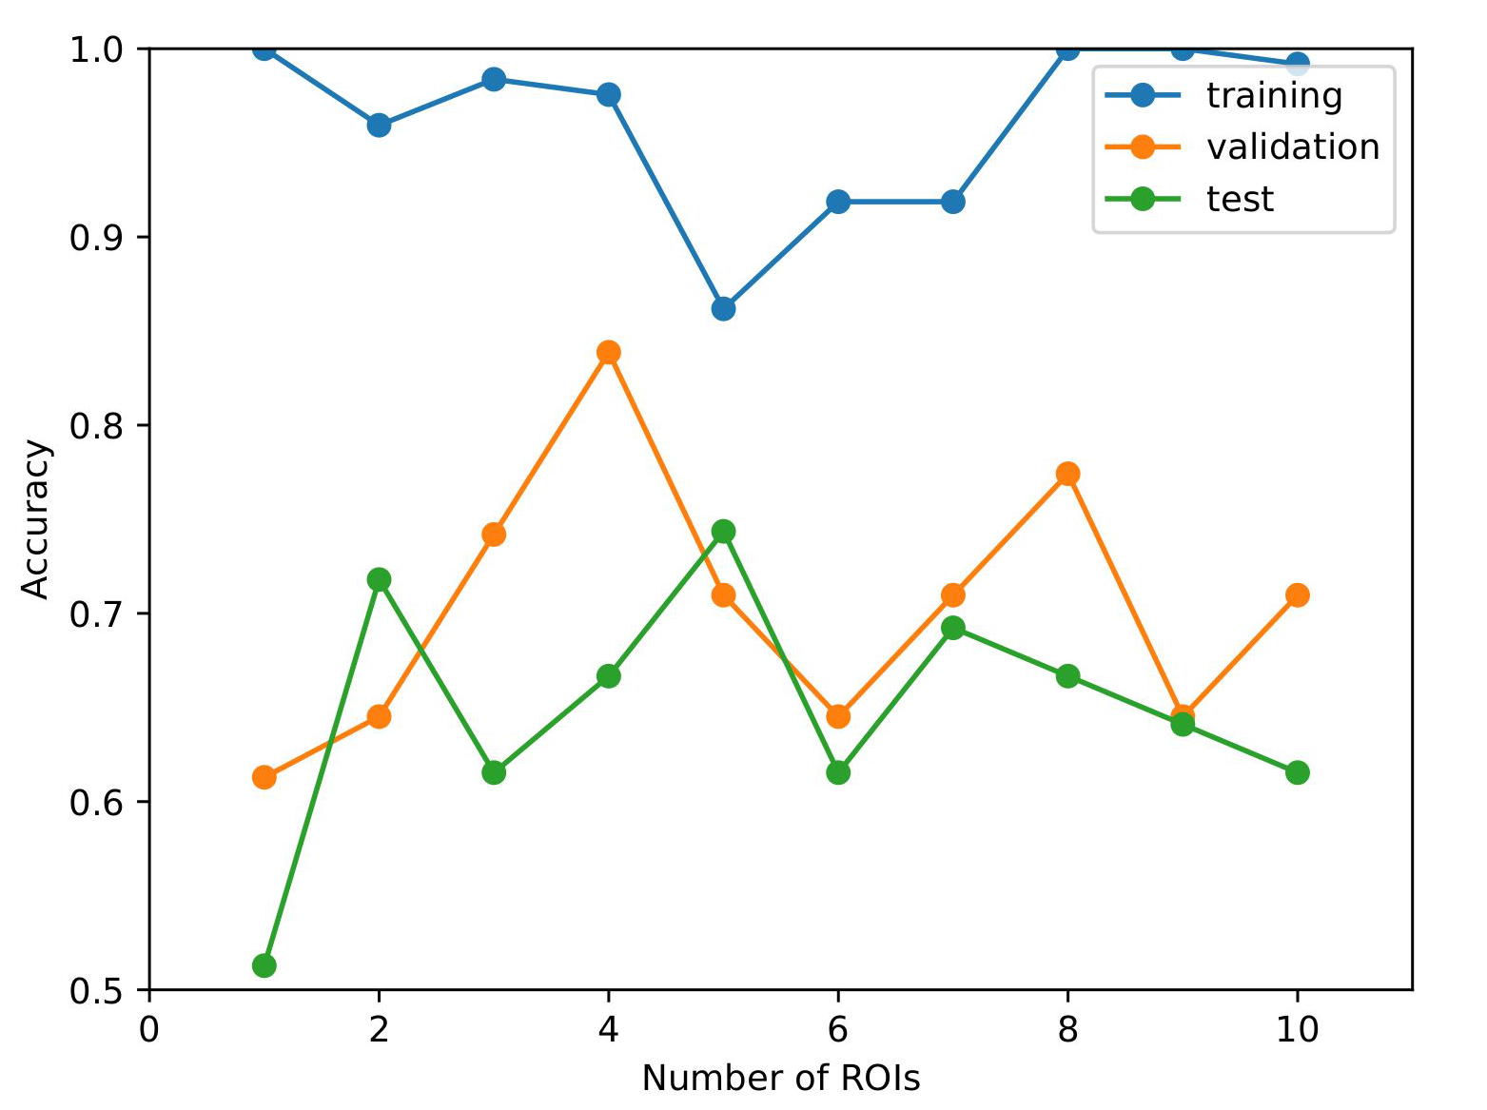
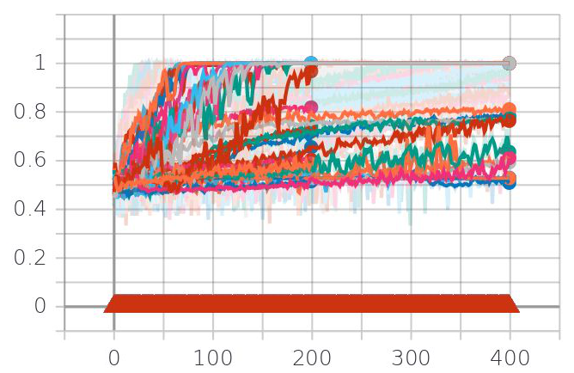
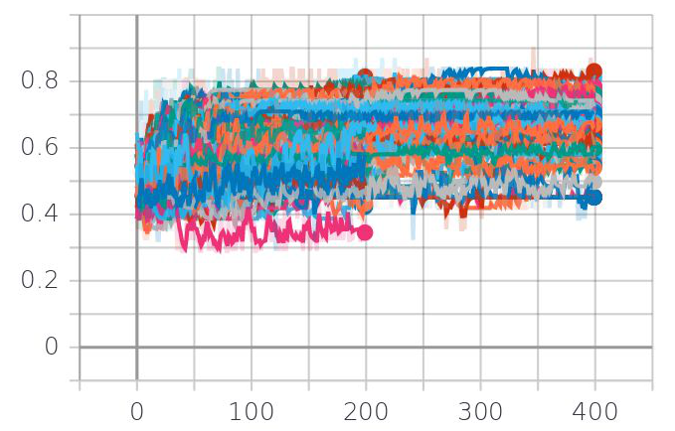
ROI Deep Neural Network Results
Training Accuracy Per Epoch
Validation Accuracy Per Epoch
Notes:
Results of the ROI deep neural network
On the left we give the training, validation, and test accuracies as a function of the number of input ROIs.
In one case → high validation accuracy of 84%
BUT → best test accuracy was 66%, for this case.
Hightest test accuracy → 74%
Hyperparameter optimization gave large range of values for both accuracy and validation

Slide 13
3D ROI Convolutional Neural Network
Notes:
The second neural network architecture we tried was a convolutional neural network with input 3D ROI images.
Once again, the number of ROIs were increased stepwise, but in this case a full 3D ROI image sees two convolutional layers before being flattened and concatenated as input to a 2 fully connected layers.
To increase the training sample size, data augmentation was employed in the form of random rotations of the input 3D images.
Hidden units in the convolutional layers and optimization hyperparameters (learning rate, epochs) were selected by validation
Classified test set as a function of the number of input 3D ROIs

Slide 14
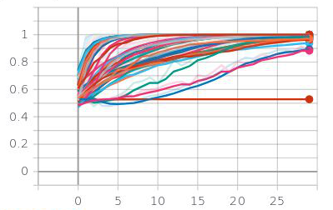
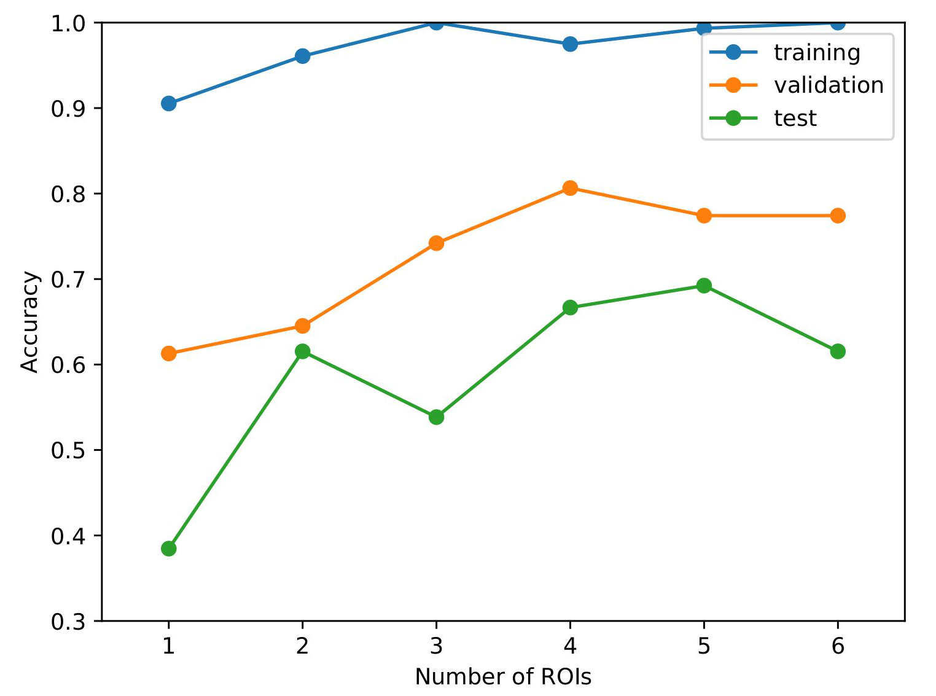
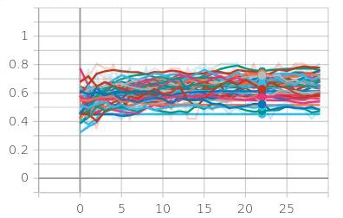
3D ROI Convolutional Neural Network Results
Training Accuracy Per Epoch
Validation Accuracy Per Epoch
Notes:
Results of the 3D ROI convolutional neural network
On the left we give the training, validation, and test accuracies as a function of the number of input ROIs.
In one case → high validation accuracy of 80%
BUT → best test accuracy was 69%, underperforming compared to the ROI DNN
However, during hyperparameter optimization, training seemed to be more consistent
Validation still had a large range of values

Slide 15
Full 3D MRI Convolutional Neural Network
RESULT: 66% Test Accuracy
Notes:
In the last neural network architectures, full 3D MRI brain scans were used as input to the network.
Similar structure to previous, but batch normalization was employed after each convolutional layer
Used Adam optimizer,
ReLU activations,
data augmentation consisted of random rotations
ONLY optimization hyperparameters (learning rate, training epochs) were selected by validation
The final result gave a test accuracy of 66% → underperformed compared to the two previous architectures.
main limitation → of this architecture was its slow speed which forbade extensive hyperparameter tuning.

Slide 16
Conclusion
Model | Our work | [1] OASIS Dataset
SVM | 66.7% [79.5%] | 70% [70.4%]
ROI DNN
3D ROI CNN
Full 3D MRI CNN
[1] Wen, et al. arxiv 2019
Acknowledgements
Data were provided by OASIS: Cross-Sectional: Principal Investigators: D. Marcus, R, Buckner, J, Csernansky J. Morris; P50 AG05681, P01 AG03991, P01 AG026276, R01 AG021910, P20 MH071616, U24 RR021382

